Slide 1
Lightning talk 3: Project Plan
Cameron Jones, Blake Hardy, Cayden Kelley, Chase O’Connell, Holden Brown, Tejal Devshetwar

Slide 2
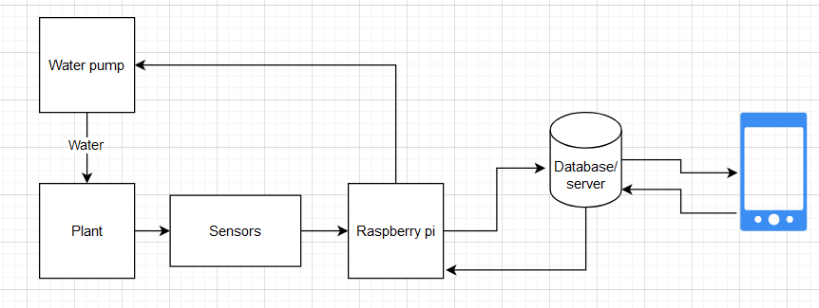
Project Overview
Create a device that automatically collects soil data (NPK,moisture,temperature).
Sends the data to a database on a server.
Create a phone app which presents the collected data of a users soil.
Server has logic that sends commands to automatically water/fertilize plants when certain conditions are met.

Slide 3
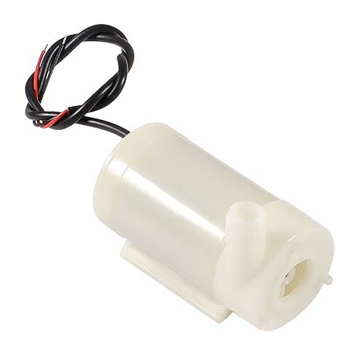
Project Management style
Management style: Waterfall
Justification: Our project can very easily be broken down into individual parts each of which are impossible to proceed with before the others.
Ex: watering system is impossible before sensor reading is complete
Ex: Core functionality of the app cannot be improved without server backend
Therefore we felt that the progression of our project would gel best with a waterfall style project management system, rather than the more modular style of agile.

Slide 4
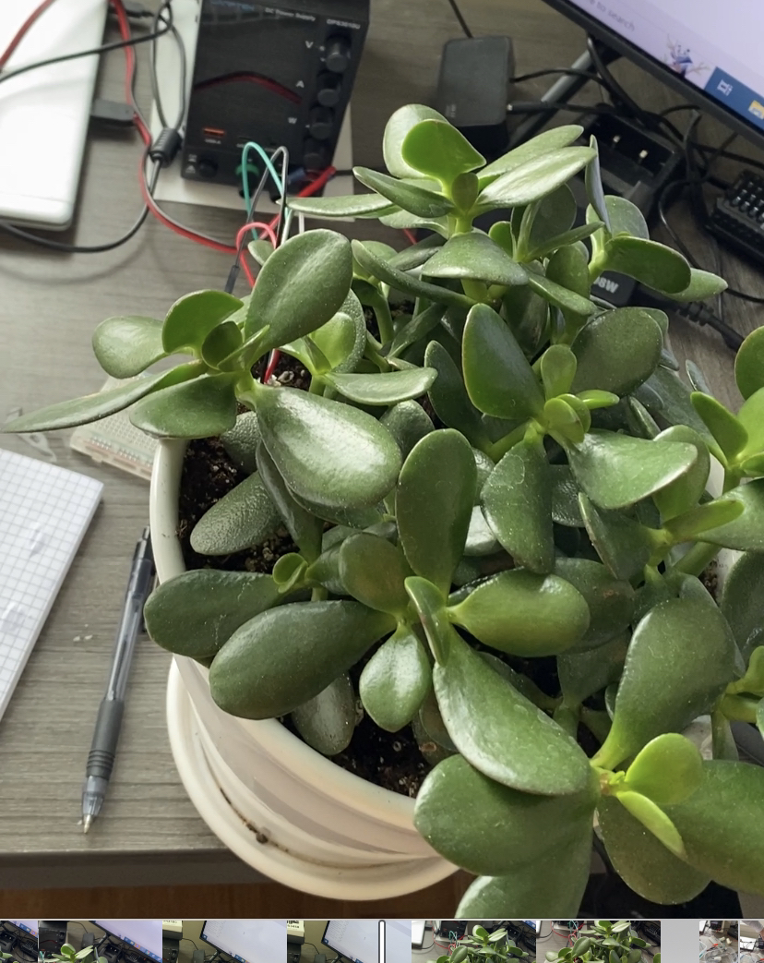
Task Decomposition
Mobile App
Design User Interface
Develop App in React Native
Deploy App to Appstores
Server/Backend Implementation
Setting up AWS Server using SQL Implementation
Roundtrip Testing between Microcontroller and App
Hardware Selection & Implementation
Research and Select Actuators and Soil Sensors
Breadboard Testing and Implementation
PCB Design and Implementation

Slide 5
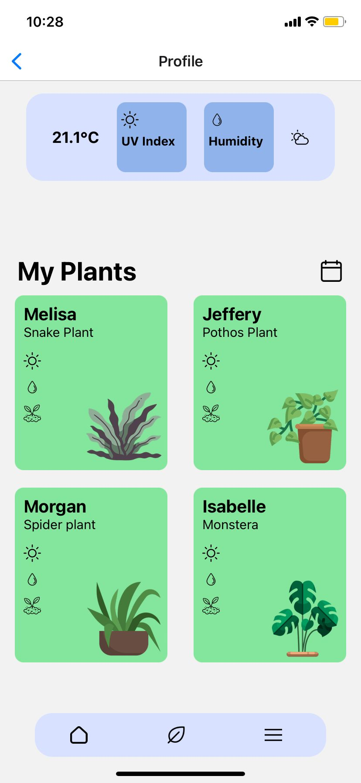
Key Milestones, Metrics, evaluation criteria
Semester goal: Complete information circuit, Sensor->microcontroller->Server->App->server->microcontroller->watering system
Correct sensor readings
Sensor calibration
Backend code complete
Working front end(both android and apple)
Working watering/fertilization control system

Slide 6
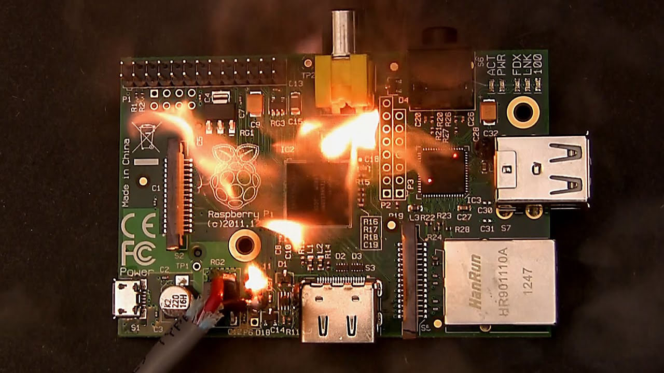
Key risks and risk mitigation strategies
Risks:
Pi is ruined by water
Sensor doesn't work/is not what we need
Database data is lost
Mitigation strategies:
Use pumps for water to keep water reservoirs away from electronics
Research sensors heavily before buying(When in doubt ask)
Perform regular data backups

Slide 7
Conclusion
Large number of software and physical components involved in this project
Frontend and backend software components (including algorithms to determine distribution of nutrients and water)
Many sensors (nitrogen, phosphorus, potassium, soil moisture, temperature, etc.)
Actuators (water and fertilizer distribution)
Waterfall project management style allows these components to be broken down and worked on simultaneously
Large number of components is a risk and a risk management strategy
If something doesn’t work, project isn’t a failure if other components are implemented well

